Slide 1
Bank Churners Dataset
Fathima Noorudheen

Slide 2
ABOUT THE DATASET
CHURNERS : The customers who frequently switch from one bank to another.
They are often motivated by various factors such as seeking better interest rates, lower fees, improved customer service, or additional perks offered by competing banks.
Churners can pose challenges for banks as they may lead to reduced customer loyalty, increased costs associated with acquiring and retaining customers, and potential revenue loss.
Notes:
Understanding churners is crucial for banks as they strive to retain their customer base and attract new clients. Banks may employ various strategies to mitigate churn, including offering personalized services, competitive interest rates, loyalty programs, and targeted marketing campaigns to enhance customer satisfaction and loyalty. Analyzing churn patterns and factors influencing customer behavior can help banks develop effective retention strategies and improve overall customer experience.

Slide 3
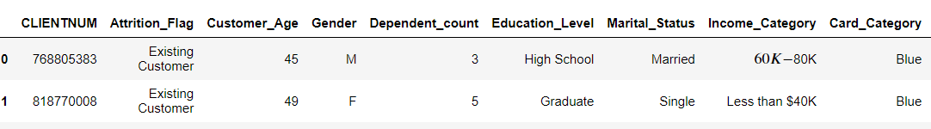
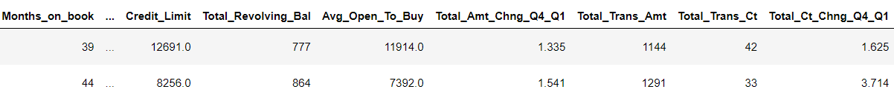
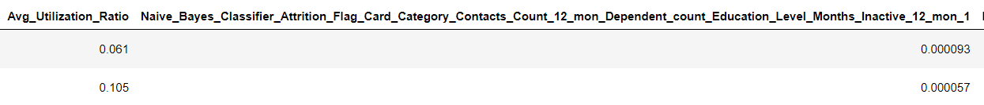
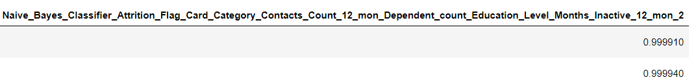

Slide 4
Exploratory Data Analysis
Churn Analysis
Customer Behavior Analysis
Financial Behavior Analysis
Relationship Analysis
Spending Behavior Analysis
Customer Segmentation

Slide 5
PREDICTIVE MODELS

Slide 6
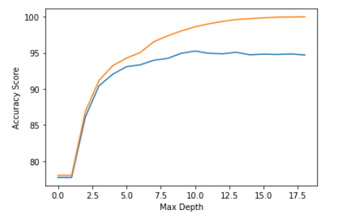

DecisionTreeClassifier
an analysis of the decision tree classifier's performance based on different depths of the tree.
Notes:
The blue line (usually lower) indicates how well the model performs on the data it was trained on. As the depth of the decision tree increases, the model becomes more complex and can potentially fit the training data better, leading to higher accuracy on the training dataset.
The orange line (usually higher initially and then may start to decrease) indicates how well the model generalizes to new, unseen data (the test dataset). Initially, as the depth increases, the model may perform better on the test data as well, but after a certain point, the model may start overfitting to the training data, causing a drop in performance on the test dataset.

Slide 7

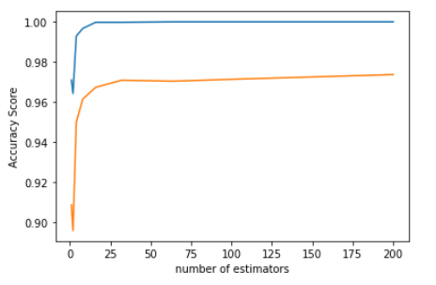
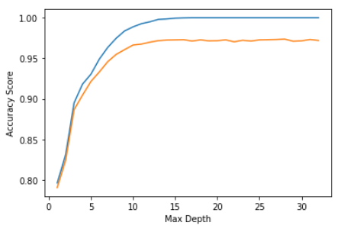
RandomForestClassifier
an analysis to determine the optimal number of estimators to use in a Random Forest classifier and the Max Depth.
Notes:
This analysis helps visualize how the number of estimators affects the performance (accuracy) of the Random Forest classifier on both the training and test datasets. It's crucial for determining an appropriate number of estimators to avoid underfitting or overfitting and to achieve the best generalization performance.
If the blue line (representing accuracy on the training dataset) is consistently above the orange line (representing accuracy on the test dataset), it typically indicates overfitting.

